Slide 1
Design Thinking
Getting into the music scene
John Halloran
Jason Arnold

Slide 2
Environments
Varsity theater
Joan of arc chapel

Slide 3
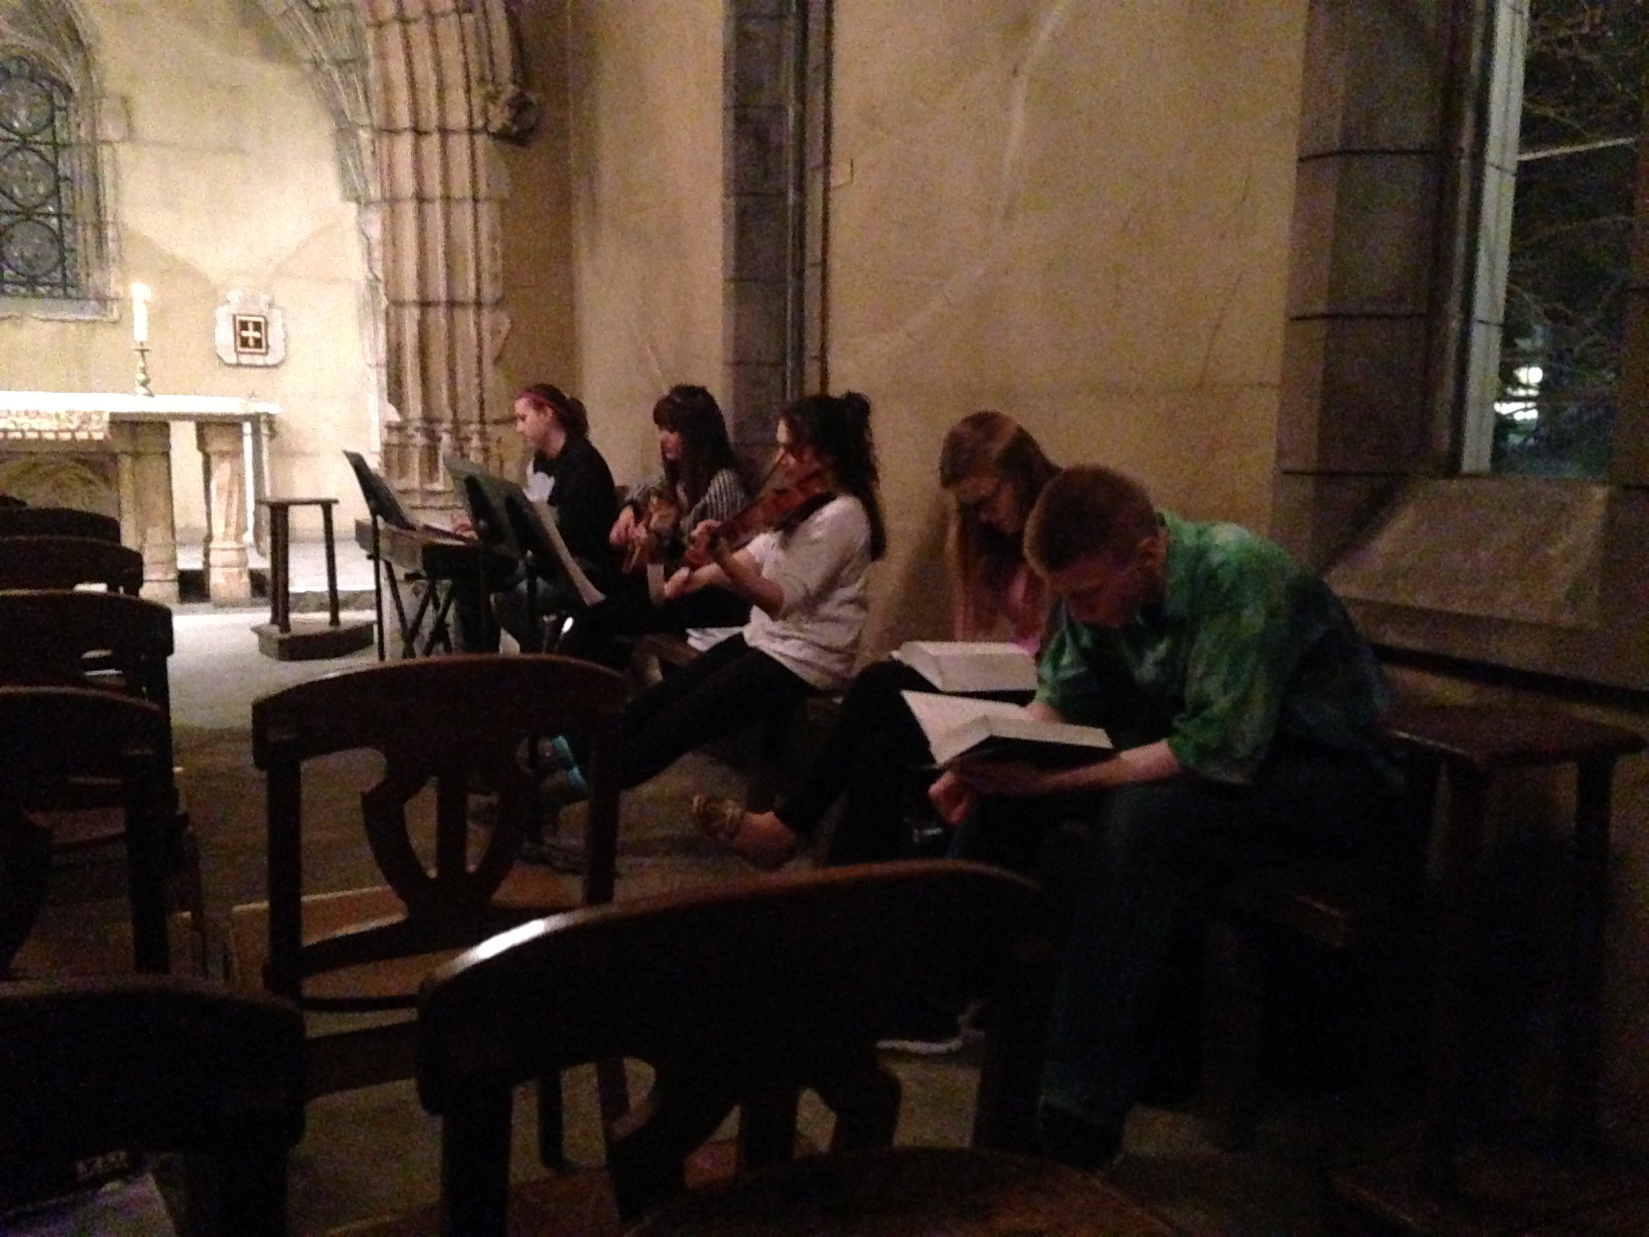

Slide 4
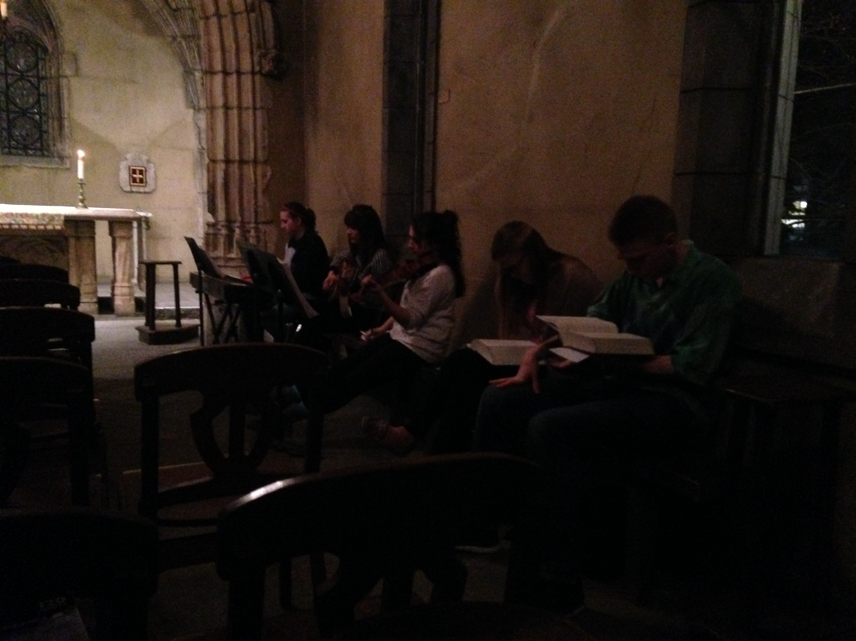

Slide 5
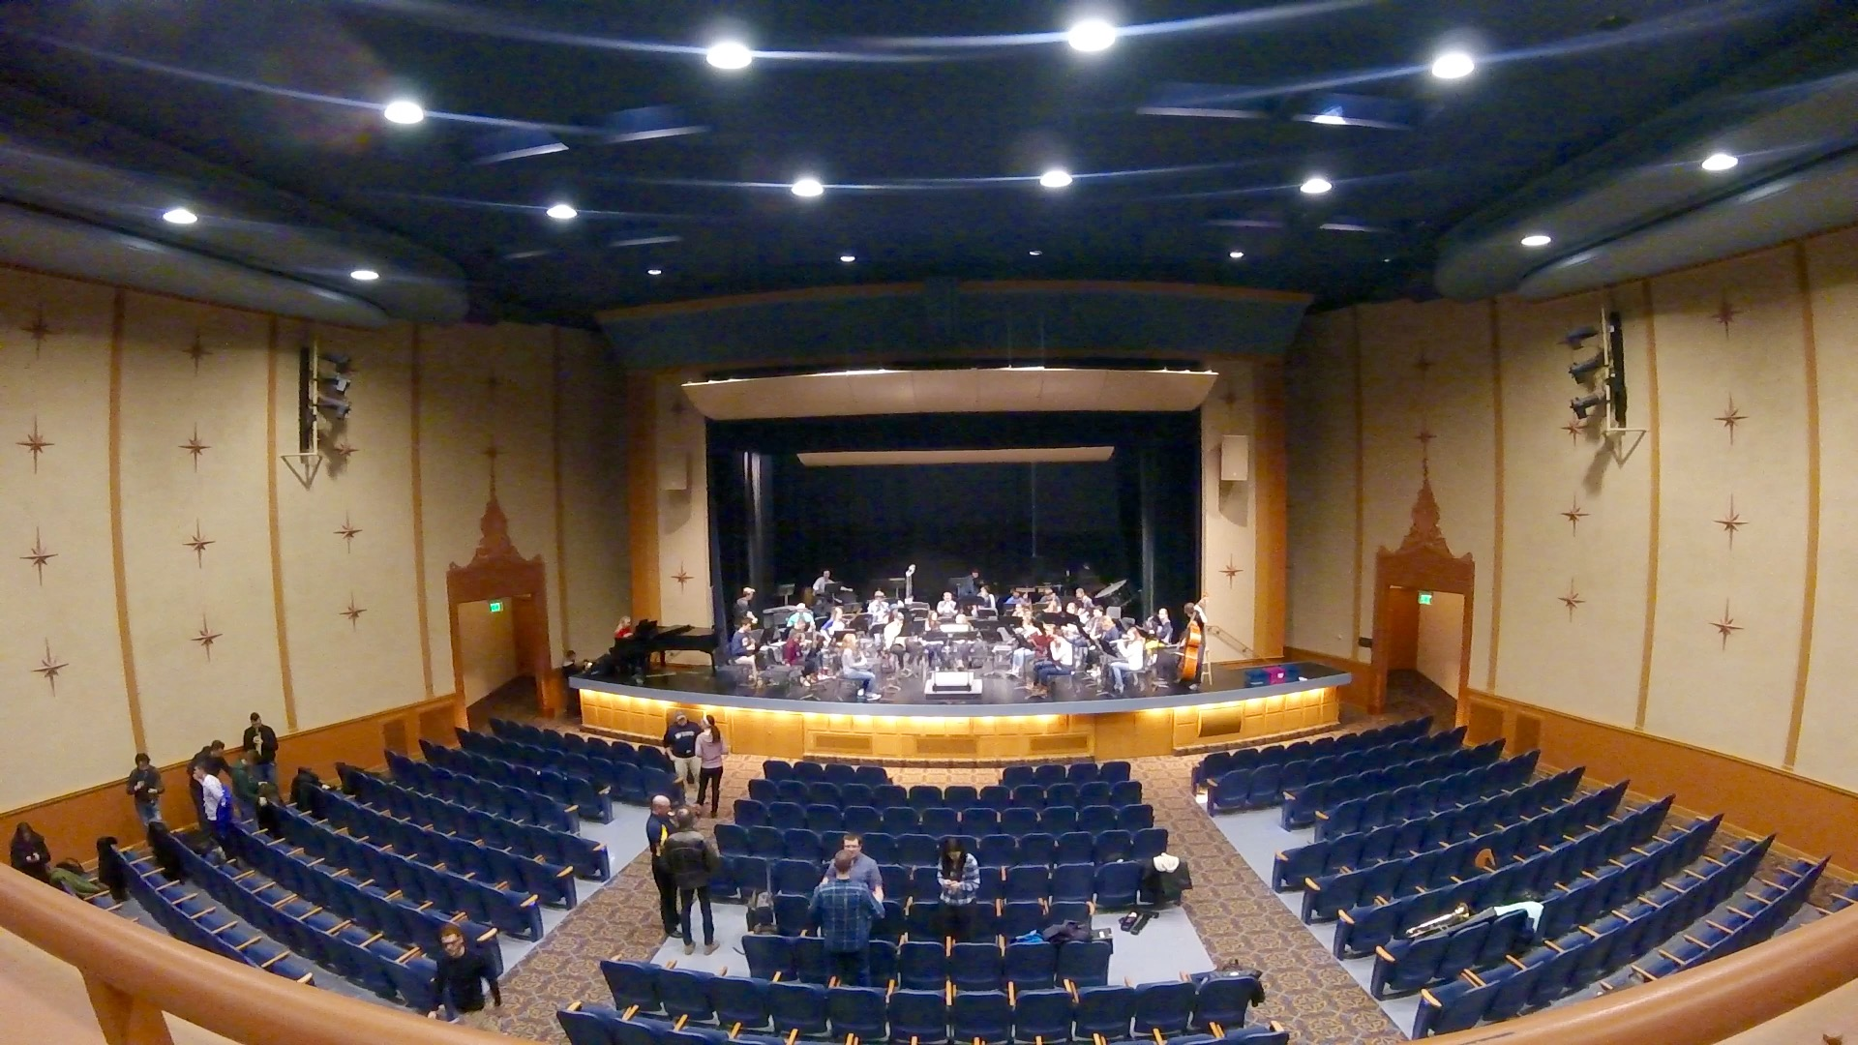

Slide 6
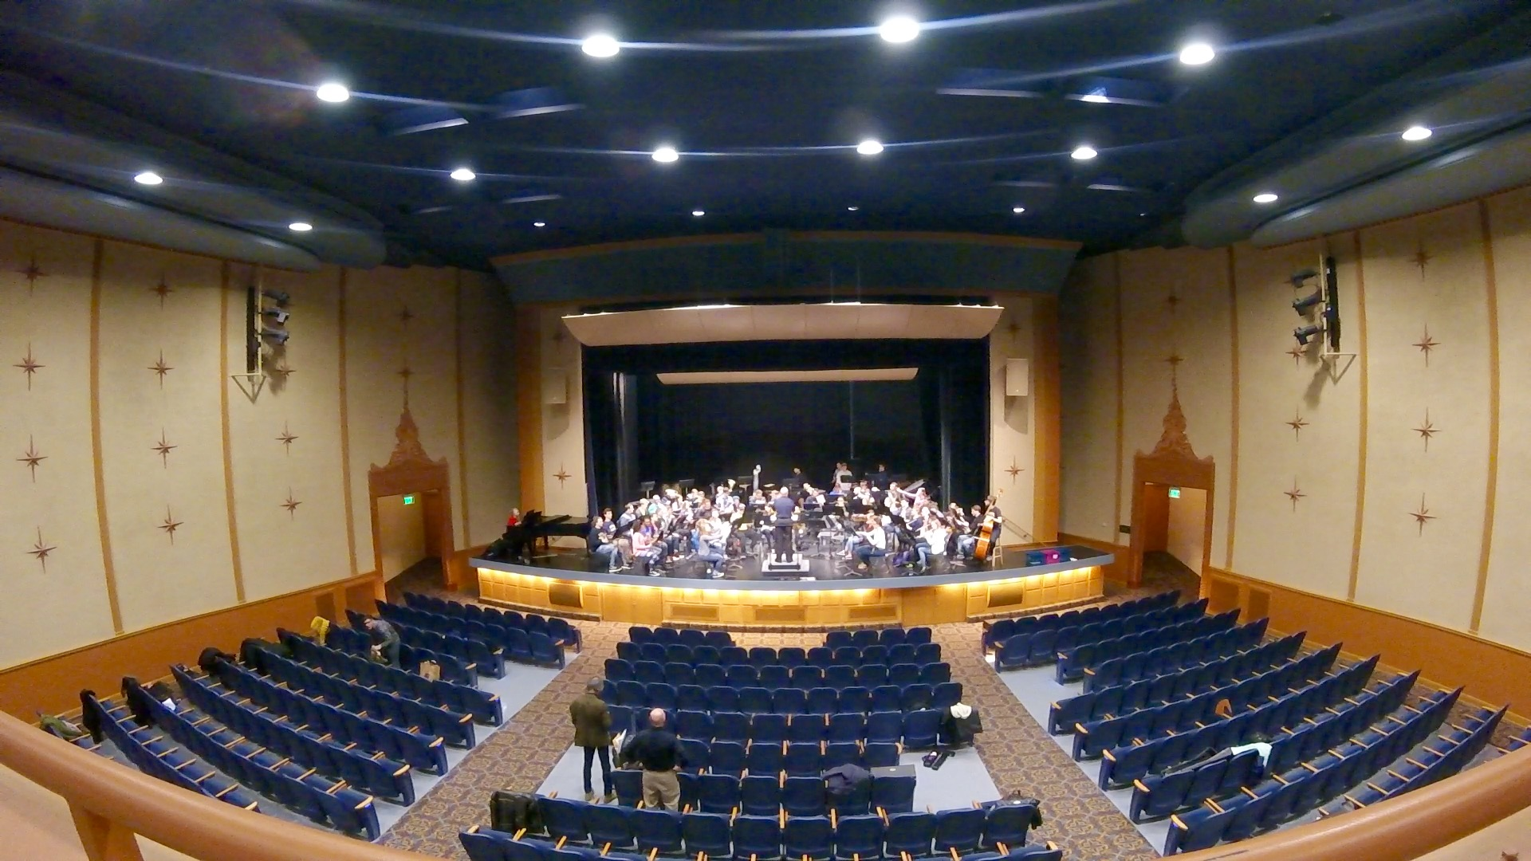

Slide 7
Joan of arc – The Environment
Small intimate space
Instrumentation is meant to invoke an emotional response with the use of piano, violin, and piano
With the hard concerete surfaces, Joan of Arc produces an immersive echo further evoking emotion
Harmonies and melodies blend together with the simple direction of the music group
Could be a difficult to keep everyone in the loop despite the small group due to noise interference from the congregation

Slide 8
Varsity Theater – The Environment
Large open space, designed for large orchestra and band pieces
Led by a conductor to control tempo and rehearsal schedule
Focus can be hard to maintain in this large group environment
Large array of personalities which can reflect in how the musicians play
Like Joan of Arc, many problems arise from understanding where you are in a piece

Slide 9

Needs
Tempo
Easy to lose sense of tempo
Music Sheets
Flipping and Noise Making
Easy to lose place
Have to look at sheet and conductor
Solutions?

Slide 10
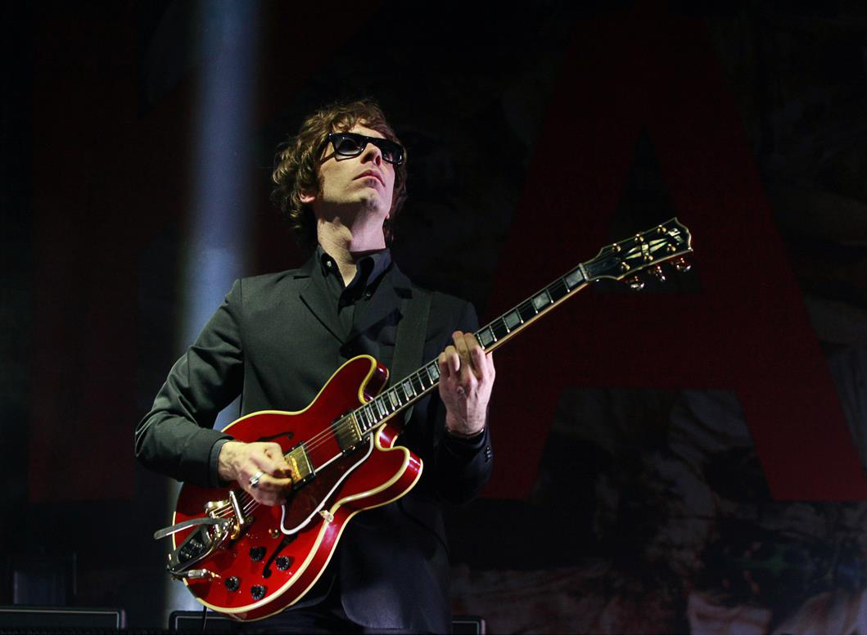
Persona – Charlie
Jazz guitarist
Spends large amount of time in group rehearsal and private practice (30 hours and 15 hours respectively)
While actively involved in a group, he is difficult to play with since when he starts doing complicated parts or starts soloing, he actually gets off tempo from the rest of the band
He needs constant work to keep himself in tempo before he does crazy things on stage in front of a live audience

Slide 11
Empathy Maps

Slide 12
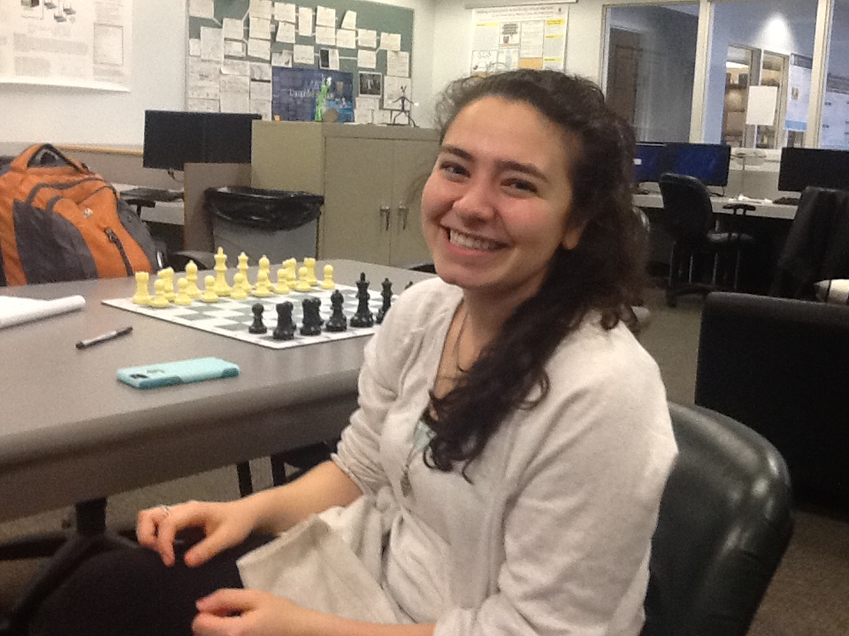
Cristina
Saying Work in groups is best Discipline is a major key | Thinking Other people challenge me I can do this New ideas I want to improve myself to get better
Doing Communicate Showing-off (bragging rights) Disciplining myself | Feeling Low self-esteem, lack of discipline Competitive accomplishment
Insights
Focused on goals
Really want to impress people
Surprises
Low-Self Esteem
Contradictions
Low Self-Esteem vs. Feeling of Accomplishment
Tensions
Trying to stay disciplined when working by yourself, but easier with others

Slide 13

Jessica
Saying Don’t want to fall behind I played something really hard Don’t want to cap out on her talent | Thinking Goal in mind Structured What is her next goal for practice Prefers to simply practice independently and improvise practice
Doing Clearing the mind Improvising Practicing a specific piece for performance | Feeling Entertained Music calms her (emotional peace) Frustrated at times, although she knows it is part of the process
Insights
Mindful of their own standing in a group
Surprises
Frustration is normal
Contradictions
Frustrations and Calming
Tensions
Frustrations over difficult pieces

Slide 14
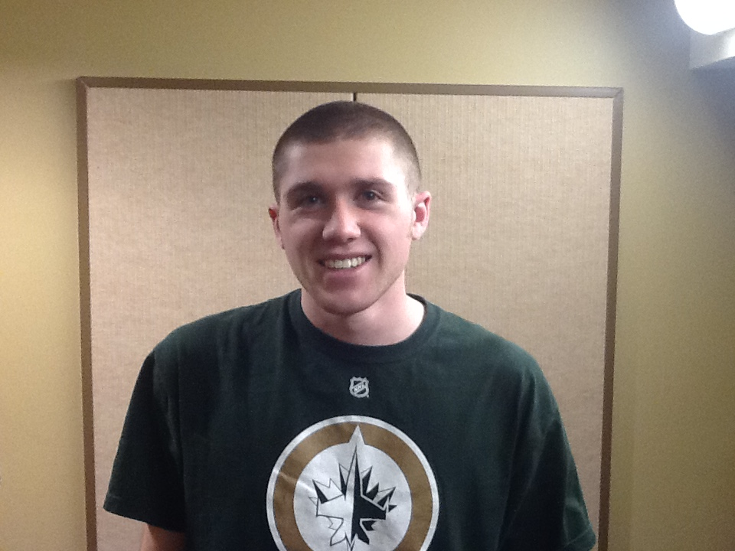
John
Saying Give me the next hardest piece Social work is most challenging, however, is definitely the most rewarding | Thinking How can I improve? What is this person I’m playing with doing? How and what can I do to better improve my partner
Doing Organized practice Improvised practice Balance the two Work in groups Plan ahead | Feeling There is always something to improve Yet still feels accomplished with how far he’s come Enjoyment from working with others
Insights
Positive Attitude is key
Surprises
A large amount of instrumental range
Contradictions
Likes setting goals, however, doesn’t know what his next goal should be
Tensions
Wants to improve, but doesn’t know which instrument to improve upon

Slide 15

Megan
Saying Organized practice is key to success Impromptu practice is the most rewarding, however | Thinking Goals Satisfaction of playing difficult pieces
Doing Trying to exercise patience (rather difficult) Understands that there is failure that comes along with practice | Feeling Impatient in groups Distracted Escape from reality
Insights
Practice, no matter what kind, is key to success
Surprises
Doesn’t enjoy practicing as much as other students
Contradictions
Seems shy but speaks confidently about music
Tensions
Can’t find enough time in the day to practice as much as she should

Slide 16
Commonalities of Interviews
Self-Motivation
Self-Discipline
Escape from Reality
Desire to always improve
Mentality that there is someone who is always better

Slide 17
Embrace the Point OF View – Back to Charlie
Charlie is a guitarist who likes to play guitar for jazz combos. He does play melodies well at fast tempos, but often gets off-beat from the rest of the band and forgets to listen to himself and others. He needs a device that can help him stay on rhythm and help him listen to himself in his own practice routine where he could play and listen to what he just played.

